Slide 1
Montessori Ivy League Teacher Training Program Month of October
By
Montessori Ivy League Management

Slide 2
Goals for our Children
Independent Critical Thinking Kids
1. Ability to communicate
a. Various cries
b. Body language and cues
c. Signing
d. Talking
e. Questions
f. Explains
g. Expresses needs
h. Solves simple interpersonal problems
2. Imitation

Slide 3
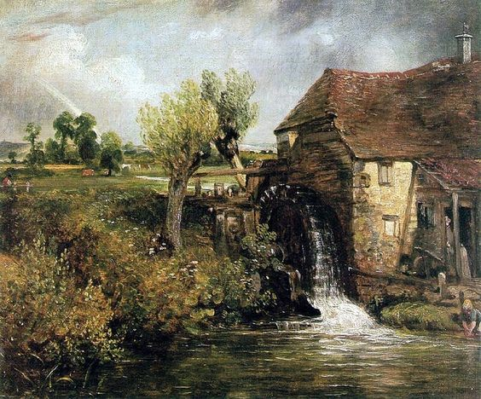
Artist of the Month
Artist: Constable

Slide 4
Practical Life
Lids and containers, Tongs, Rolling a mat, Blowing nose, Snapping, Mopping the floor, Spreading cream cheese, Sorting by colors, Grasping large/small, Puzzles, Scooping, Stringing
Videos:
Click here for Unrolling a mat
Click here for Rolling a mat
Click here for Snapping
Click here for Spreading cream cheese
Click here for Scooping
Click here for Tongs
Click here for Stringing
Click here for Mopping the floor
Click here for Sorting by colors
Click here for Scooping
Click here for Lids and containers

Slide 5
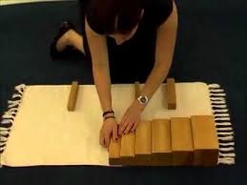
Sensorial Curriculum:
Brown stairs
Click here for Brown Stairs video

Slide 6
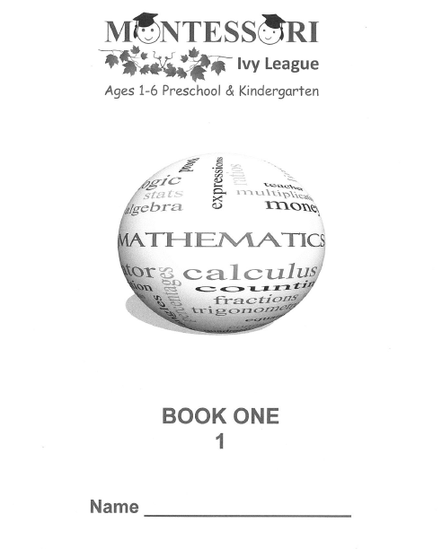
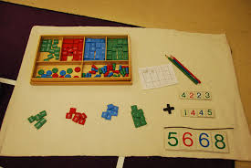
Math Curriculum
Concept of the numbers: 6,7,8,9,0,10
Click here for Math (Odd & Even)
Click here for Math three period lessons
Click here for Simple addition

Slide 7
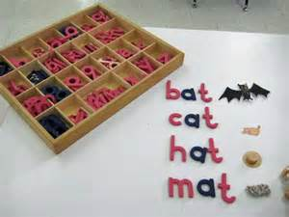
Language Curriculum
Click on the link below for videos:
Concept Development, 3 period lesson
Words Around The Classroom
Object to picture
Matching words with Pictures
Matching picture with picture
Sound Lesson
Pink Series
Sounds Bingo
Matching Sand Paper Letters with objects
Blue Series: Initial blends
Green series

Slide 8
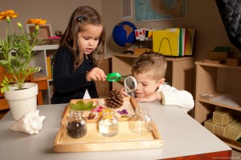
All Sciences: Biology, Botany & Zoology
Videos
Sinking and floating
Watering seeds

Slide 9
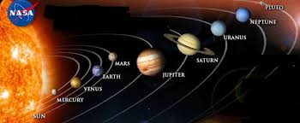
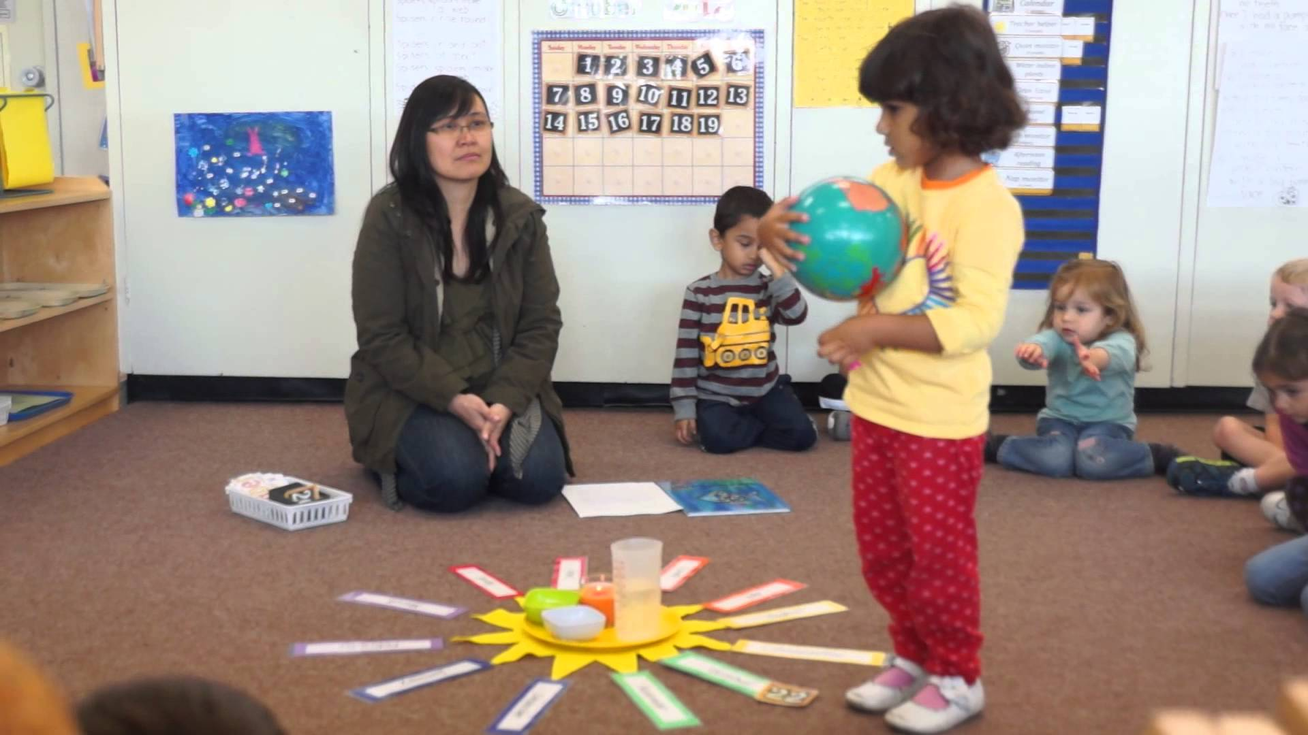
Geography
Solar System study
Science Lesson - Solar System
Montessori Birthday Ceremony
Continent Map
The Continent Song
Flags :
Dominican Republic,
Mexico
Australia
Canada

Slide 10
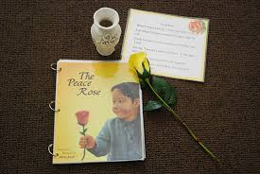
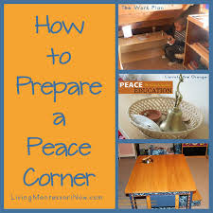
Peace Curriculum:
In the Montessori Classroom (Pag # 14),
General Courtesy (Pag # 15)
Grace and Courtesy :
Taking turns

Slide 11
History: Christopher Columbus

Slide 12
Art
OCTOBER
Seasons Tree
Paul Klee's Art work
Paper Plate Continents
Seasons Tree
Paul Klee's Art work
Paper Plate Continents

Slide 13
Seasons Tree

Slide 14
Paul Klee's Art work

Slide 15
Paper Plate Continents

Slide 16
Continents

Slide 17
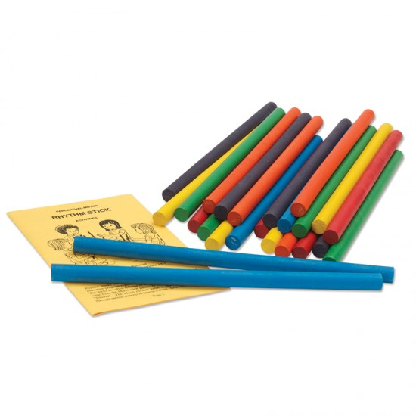
Music and Movement
Rhythm Sticks
https://www.youtube.com/watch?v=nLfEW3SwpdI

Slide 18
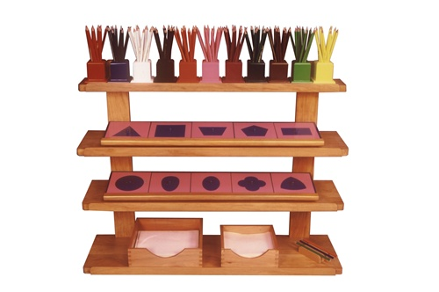
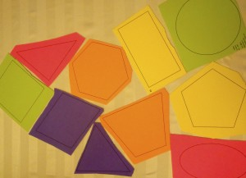
Metal Insets
Metal Insets: https://www.youtube.com/watch?v=_sQWUO2jT2o

Slide 19
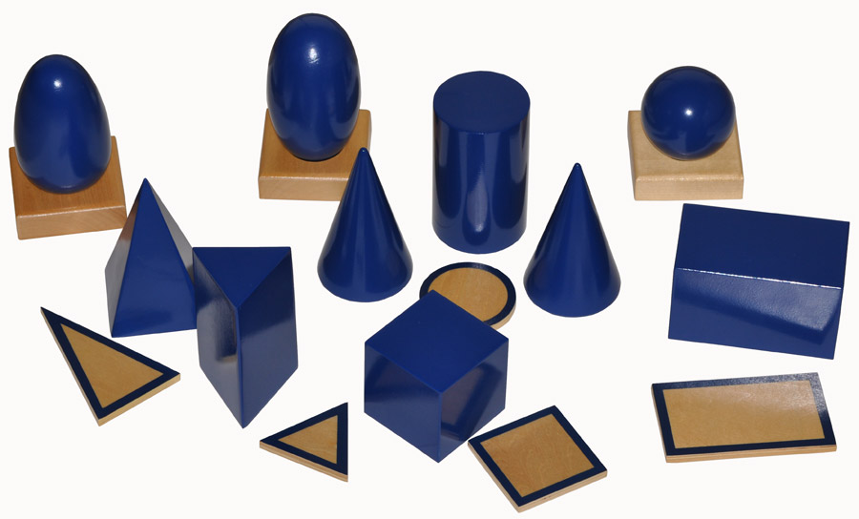
Geometry Curriculum
Montessori Geometric Solids:
https://www.youtube.com/watch?v=wBXVeLNc2dc

Slide 20
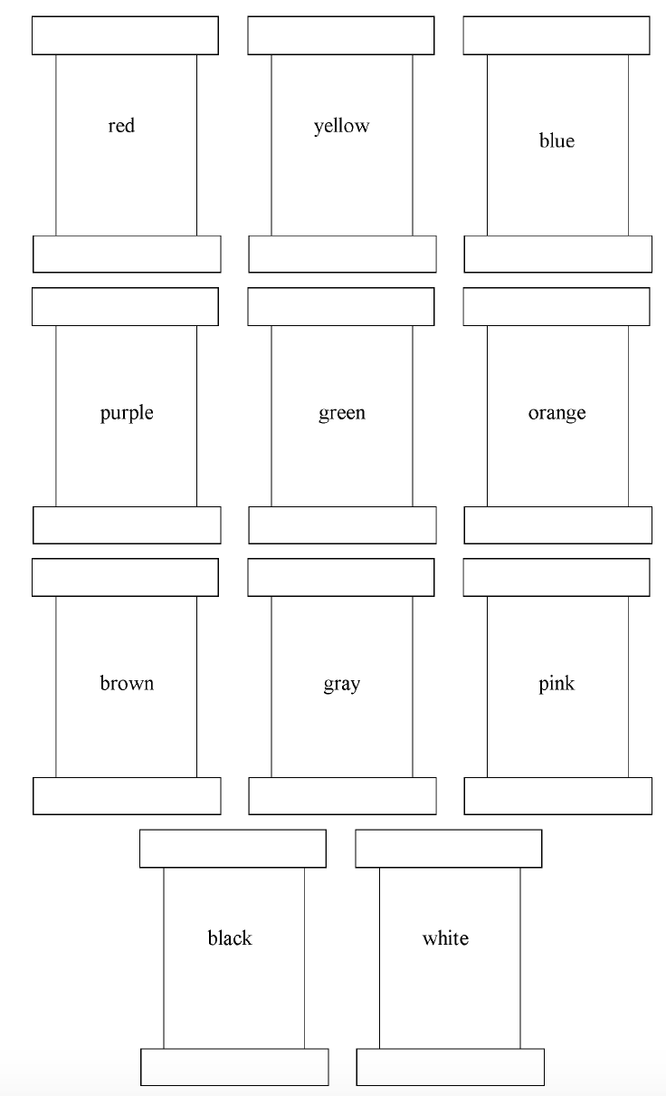
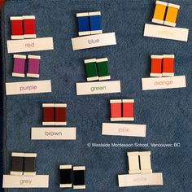
Colors
Orange
https://www.youtube.com/watch?v=eNDCAtm06JU
Color Box # 2
Color Box 2

Slide 21
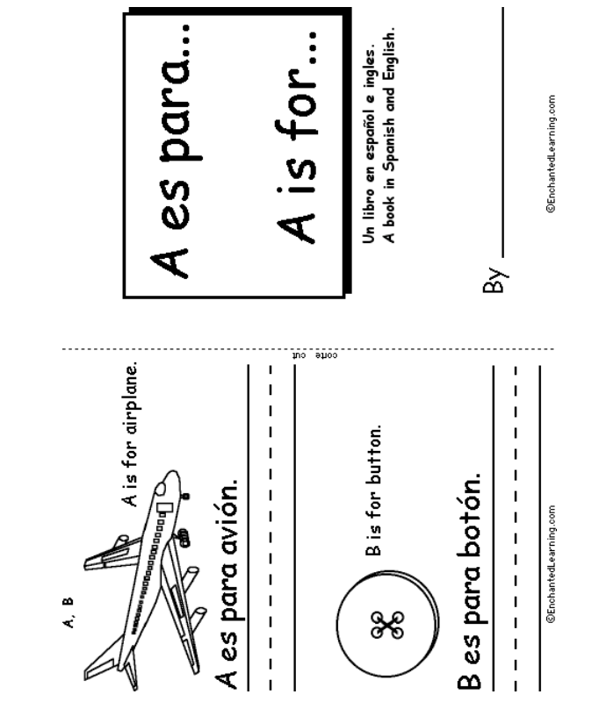
Spanish curriculum
A-z (small workbook in English and Spanish)

Slide 22
Montessori Routine
Day and night,
Seasons,
Days of the week,
Months of the year,
Weather,
Recording the weather,
Holidays

Slide 23
Montessori Principles for the Montessori School Leader
Montessori Principles for the Montessori School Leader https://vimeo.com/ondemand/montessoriprinciples/178656618

Slide 24
Q & A
Any questions ?

